Slide 1
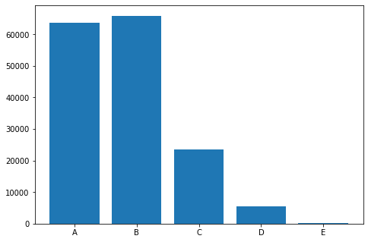

Slide 2
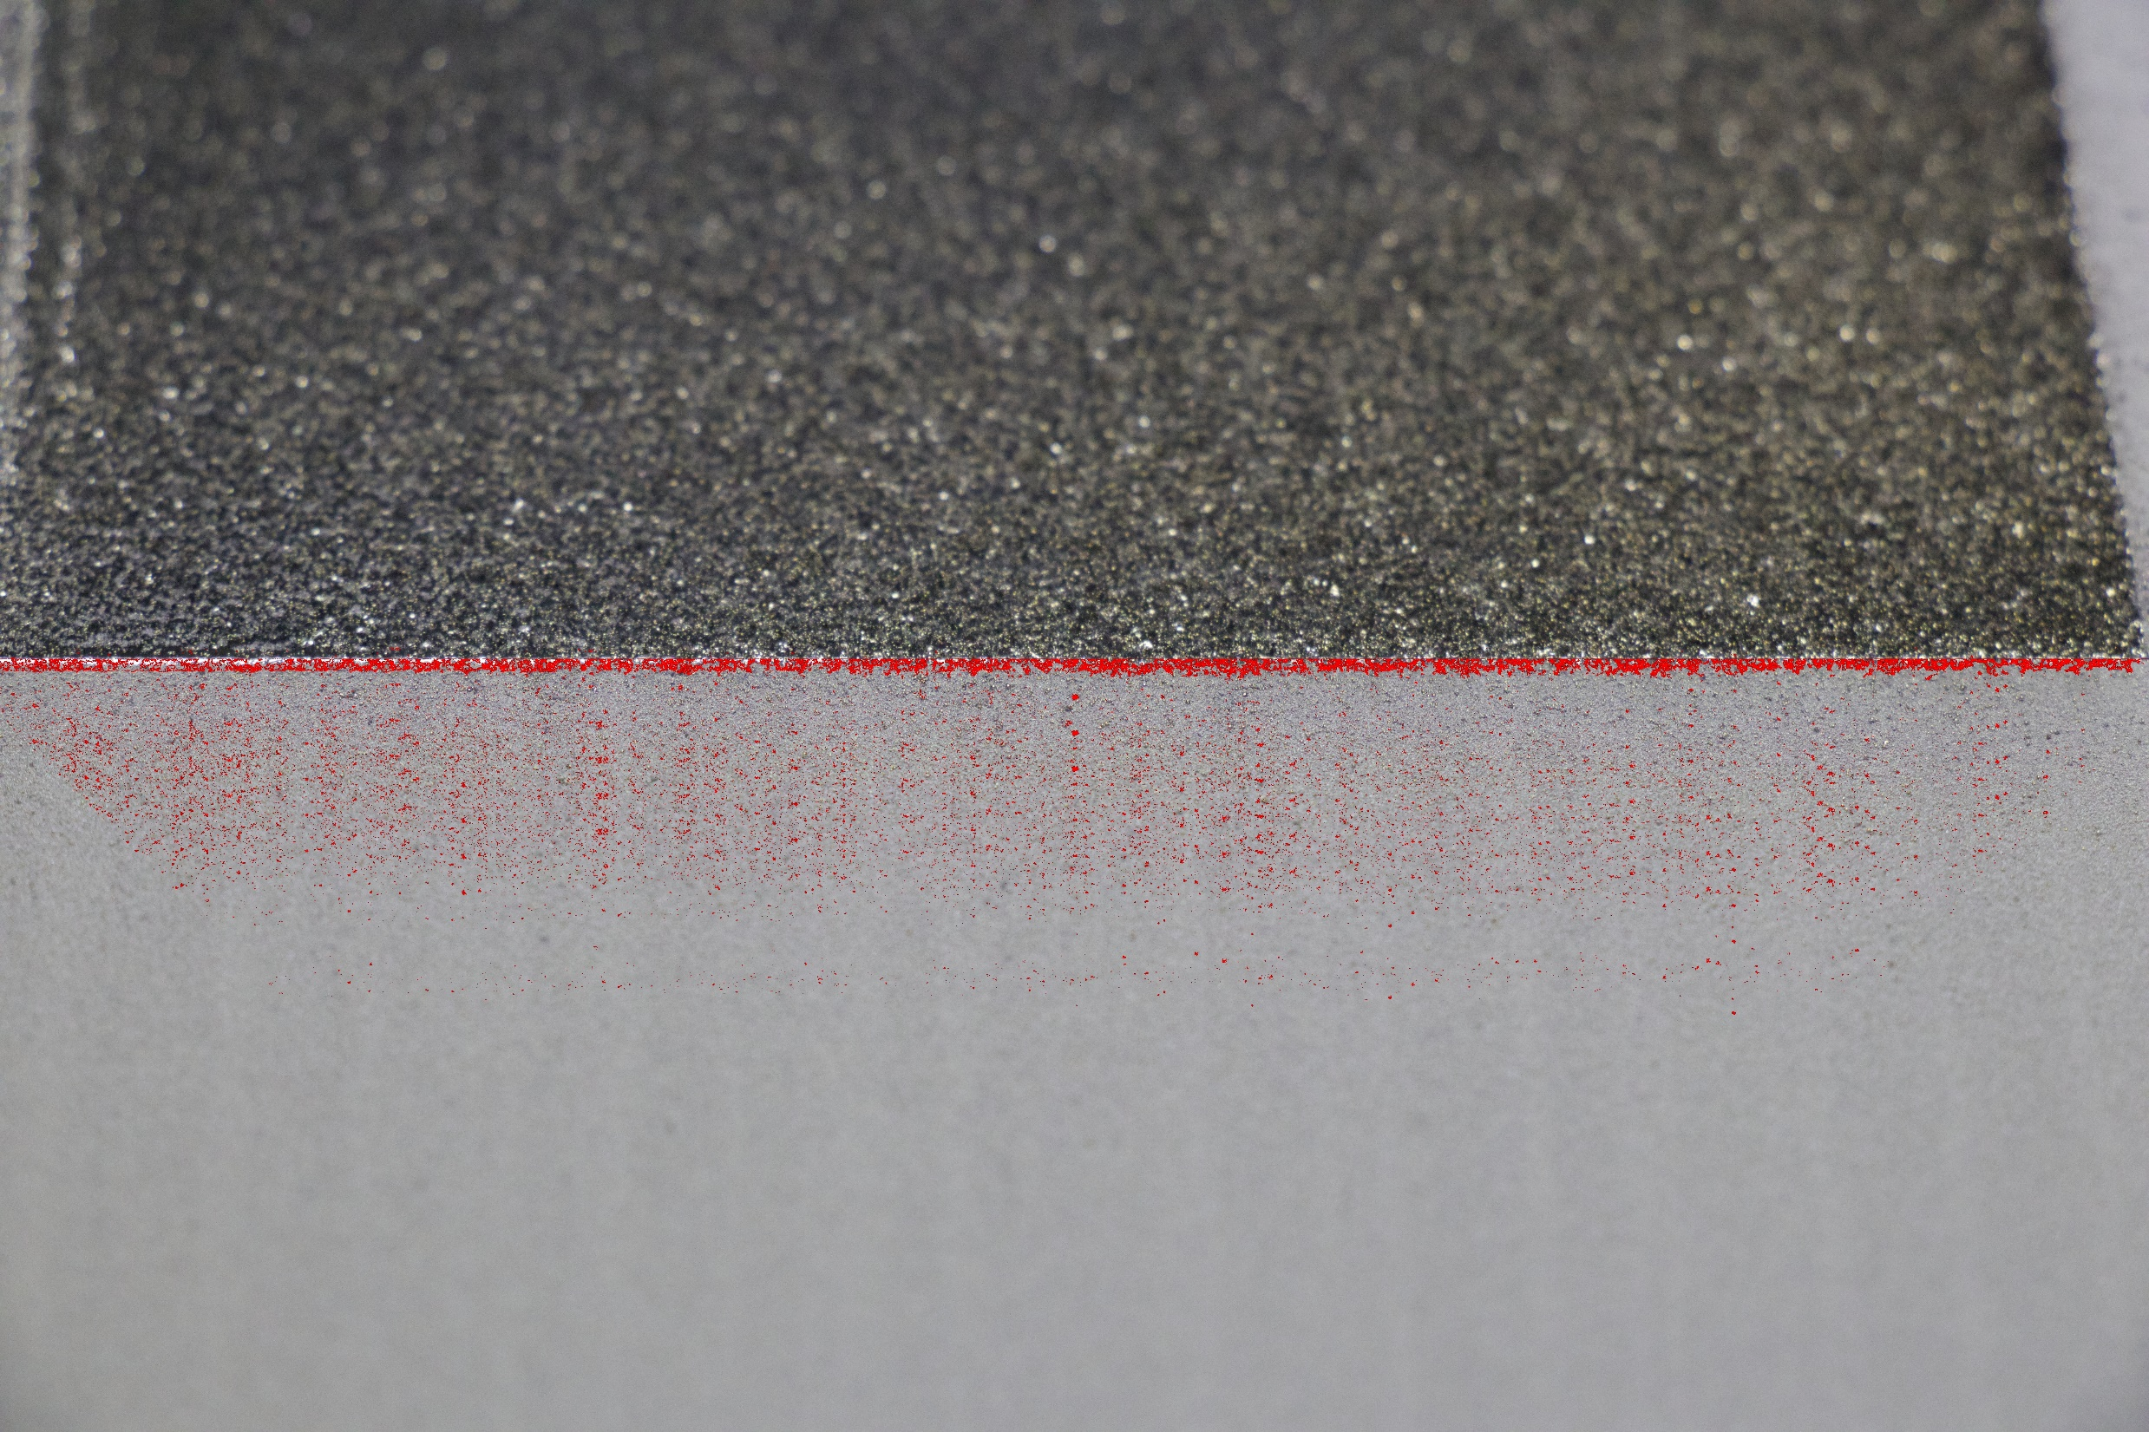
0 mm
2.7 mm
5.4 mm
8.1 mm
10.8 mm
13.5 mm

Slide 3
